Slide 1
Executive Guide to Hyperautomation
Frances Karamouzis
Stephanie Stoudt-Hansen
Nicole Sturgill
Laurie Shotten
Notes:
Version: 2020-0108
Presenter's Name
Presenter's Name

Slide 2
Hyperautomation Principles are the Foundation for the “Future of Work”
Accelerate Digital
Business Creation / Market Maker
Business Operations
(Re)Invention
Resilient, Composable Business Models
Business Outcomes
Orchestration
Across Functions
Orchestrate Fusion Teams for Resiliency and Adaptability
Process Automation
Go Beyond “Technical Debt” Focus on reducing Process Debt
Revenue Shifts / Profit Margin
Task Automation
Hyperautomation raison d'etre (remit) is “HOW” we work
Narrow
Scope of Automation
Broad

Slide 3
Continued Unabated Investments in Hyperautomation Despite the Crisis
Strategic Investments
Governance
Governance
85% will increase or not change Hyperautomation investment strategies over next 12 mos.
40% will have 4 or More
Concurrent Hyperautomation initiatives to Manage & Operate
16% will have 15 or More
Concurrent Hyperautomation initiatives to Manage & Operate
Polling data from Nov 2020 webinar titled: The Gartner 2021 Predictions: Accelerate Results Beyond RPA to Hyperautomation
Number of respondents = 184 to 399 (depending on question).
Q1: How would you characterize your organization’s Hyperautomation investments over next 12 months?
Q2: How many Hyperautomation initiatives are taking place with in your organization?

Slide 4
Continued Unabated Investments in Artificial Intelligence Despite the Crisis
Value Seeking
Strategic Investments
75% will Continue or Start New AI Investments in
next 6 to 9 months
66% will increase or not change AI investment strategies (since onset of crisis)
Growth
Containment
50% PRIMARY AI Investments is focused on Revenue Growth or CX/Retention
30% PRIMARY AI Investments is focused on
Cost Optimization
Polling data from Septe 2020 webinar titled: Driving Strategic Mandates for AI in the Enterprise
Number of respondents = 150 to 200 (depending on question).

Slide 5
Foundational Content

Slide 6
Gartner Definition of Hyperautomation “Business-driven hyperautomation is a disciplined approach that organizations use to rapidly identify, vet and automate as many business and IT processes as possible. Hyperautomation involves the orchestrated use of multiple technologies, tools or platforms. Examples of these include AI, machine learning, event-driven software architecture, robotic process automation (RPA), BPM/iBPMS, integration platform as a service (iPaaS), low code/no code tools, packaged software and other types of decision, process and task automation tools.”
Notes:
Definitions

Slide 7





Hyperautomation Enables Debt Reduction
3
Deliver/Production
Business Objectives (Digital Ambition)
1
Measure, Iterate, Optimize
5
Deliver
Solutions
Imagine
Vision and Options
Explore
Prototypes
Scale
Outcomes
2a
Business Process Analysis
2b
Technology Exploration
4
Govern and Scale

Slide 8
Hyperautomation Portfolio of Technologies
Artificial Intelligence
Machine Learning
Chatbots/Conversational Platforms
Event-Driven Software
Process Mining/Discovery Tools
RPA/CoRPA/iBPMS/iPaaS
Low Code/No Code

Slide 9
2021 Predictions: Accelerate Results Beyond RPA to Hyperautomation
By 2025, more than 20% of all products and produce will first be touched by a human at the time of purchase.
By 2024, one or more technology megavendors will build or acquire targeted hyperautomation technologies rendering 60% of the standalone RPA market offerings redundant.
By 2024, more than 70% of the large global enterprises will have over 70 concurrent hyperautomation initiatives mandating governance or facing significant instability.
By 2024, 80% of hyperautomation offerings will have limited industry-specific depth mandating additional investment for IP, curated data, architecture, integration and development.

Slide 10
Demand & Business Drivers

Slide 11
Hyperautomation Is Inevitable and Irreversible
Work From Home has accelerated “Default is Digital”
Expect that everything that can and should be automated will be automated.
Everything else must be augmented. Augmenting business decisions.
Notes:
Placeholder for text (substitute your own text; delete when not used)

Slide 12
Gartner CEO study: Top 5 Concerns About Managing Future Workforce
Ranked No. 1 Challenge
Outdated Work Processes
Pent Up Demand
Notes:
Business executives are demanding digital operational excellence which creates a demand for automation. The result is tremendous pent-up demand for speed – essentially lower cycle times, efficacy – lower error rates and scale across many processes. This has triggered an enormous backlog of business stakeholders’ requests to apply one or more intelligent automation technologies. This situation has been heightened by the pandemic and the sudden requirement for everything to be “digital first” to enable remote working. Gartner views hyperautomation as inevitable and irreversible
Placeholder for text (substitute your own text; delete when not used)

Slide 13
Breakdown of Analytics and Technology-Driven Work Across the Organization
5%
Technology Producers in Business Unit IT and Data and Analytics Departments
5%
Technology Producers in Central IT Departments
41%
Technology Producers in Business Units and Corporate Functions
(outside of IT)
49%
Technology “End Users”
Dependent on the industry, the share of technology producers outside of IT ranges between 54% and 26% of the workforce.
n = 4,977 employees across the entire workforce
Source: 2020 Gartner Digital Friction Survey
Notes:
Placeholder for text (substitute your own text; delete when not used)

Slide 14




Business Technologists (Not “Just” Citizen Developers)
Reasons Why Business Technologists Do What They Do
Corporate IT Has Not Kept Up With Demand
Employees Have Greater Technology Ambitions
Being a Business Technologist Is Formally Recognized as Part of the Role
76%
73%
My IT department … could not provide the capabilities fast enough
…did not provide the right capabilities
My enterprise … encouraged me to build information technologies
I wanted to develop my technology skills
About half or more of their personal performance objectives explicitly mention modifying or building data or tech solutions
n = 2,015 business technologists
Source: Gartner 2020 Digital Friction Survey

Slide 15
Industry Debt
Debt
Technical
Process
Organizational Debt
Data
Architecture & Security
Talent
Social
Notes:
Technical debt is the most well-known form of debt. It’s a proxy for …complexity, lack of speed to change and most of call – the need for increased cost/investment
For many years, the discussion of TECHNICAL Debt is used by IT to articulate and discuss limitations that prevent IT teams from saying “yes” to the business
Technical debt is rarely expressed as a quantitative number. The value of discussing debt isn’t in trying to precisely quantify it. Rather, the value is in helping raise awareness of important concepts among stakeholders.
Here we highlight that there is MUCH MORE than technical debt, there is a lot of PROCESS debt and DATA debt, and SECURITY debt, and ARCHITECTURE debt etc.
And we always refer to this debt in a very amorphous way
The other “chicken and egg” question is WHICH TYPE OF DEBT is driving the most pain or intractable problems in our organizations?
Bottomline – the exact size (volume), shape, scope and “priority” of this debt is hard to measure and varies greatly based on the business problem.

Slide 16
C-Level Mandate: Shift From Debt to Liquidity
Debt
Liquidity
Technical
Technical
Process
Compose the Future
Process
Data
Data as Asset and Data Literacy
Architecture & Security
Architecture & Security
Talent
Talent
Social
Social
Notes:
What if we were to use composability and modularity concepts to look at different elements of debt AND how we make move strive each one from a negative state of being the RED (debt ridden) to be more LIQUID ( more agility, malleability) We would use the lego blocks of Composability.. LESS DEBT and MORE LIQUIDITY results in a higher composability index
As business executives continue to strive for digital operational excellence and the demand for speed and efficacy continues, it’s necessary to look beyond IT. It’s important to look at the collective debt from not only technology but process, data, architecture, talent, security and social/community demands. We summarize these terms as follows:
Process debt — Suboptimal activity or process that might have some benefits, but generates a sustained negative impact on cycle time, error rates, quality, consistency, complexity or customer experience.
Data debt — Lack of or suboptimal access to current or accurate data within the demand latency period.
Architecture debt — Suboptimal solutions from an optimized architectural construct. This may lead to security issues, latency and redundancy (in applications, infrastructure, instances, APIs, licensing or subscription costs).
Talent debt — Lack of talent (human workers, augmented humans or virtual workers) in either the quantity, quality or ability to scale to fuel optimization or growth.
Security debt — Inability to proactively or reactively address a broad set of security risks or breaches. Security debt ranges over a broad spectrum from physical security to cybersecurity and many areas in between.
Social debt — Suboptimal activity or a sustained negative impact on the organization’s ability to address social, societal and community issues. For example, if an organization wants to address climate change issues but lacks the agility because of its culture, diversity, talent or other factors, then the organization has high social debt.

Slide 17
C-Level Mandate: Shift From Debt to Liquidity
Debt
Technical
Liquidity
Process
Compose the Future
Technical
Data
Process
Data as Asset and Data Literacy
Architecture & Security
Architecture & Security
Talent
Talent
Social
Social

Slide 18
Compose the Future: Focus on Liquidity
Results
Modularity
Composability
Debt Reduction
More Liquidity
Increased Reaction Time, Agility
More Composability
More Resiliency
Attract Talent, Partners, Ecosystems
Address Societal, Community Issues
More Resiliency
Competitive Advantage

Slide 19


Business Focus
Labor Arbitrage
Automation Arbitrage
Cheaper
Better
Cheaper
Faster
Faster
Cheaper
Better
Notes:
For many many years – we were all focused on Cheaper cheaper cheaper… we expanded to areas like India, Phillipines and many other places with an eye towards LABOR arbitrage.
We are now in 2021 and over 90% of Fortune 1000 companies say “been there, done that” when you bring up India. They actually expound and talk about lots of other countries beyond India.
And for the last 5 to 7 years – the focus has SHIFTED to Automation Arbitrage
And we turned this whole approach on its UPSIDE down.
Automation Arbitrage is about BETTER first, then FASTER. And as a by product of Better and Faster – you will get CHEAPER

Slide 20
Strategy
Notes:
This is why you need to be concerned. We expect this to grow rapidly as the SaaS vendors move to monetize this.

Slide 21



Strategic Articulation
Human-Instructed
Machine Learned
Code Driven (Rules Based)
Data Driven (Learned)
Data
Cause
Outcome
Data
Data
Effect
Cause
Cause
Outcome
Effect
Effect

Slide 22




Strategic Articulation of AI
Code Driven (Rules Based)
Data Driven (Learned)
Not AI
AI
Behavior managed by:
Human-Instruction
Human-Understanding
Human-Testing
Human-Constraints
1
2
3
4
No Go
Machine follows rules defined by humans
Machine learns; result is fully testable, traceable, and understood before deployment
Machine learns; resulting black box is testable before deployment
Machine continues to learn after deployment, but is kept in check by constraints
Notes:
Execs may want more sophisticated AIs, which in theory lead to better outcomes, but this comes at a price. It’s harder to predict the behaviour of machine-learned approaches (esp. continuous machine learning). Although “smarter” in the sense that they learn from existing (and in #4, changing) conditions, they present greater risks. Humans try to guarantee the behaviour of an AI by the approaches listed in slide. Level 4 requires that humans let the machine do its thing, but will require human-imposed constraints that will keep it within bounds.

Slide 23
Strategic Articulation
Capability Grows
High Capacity / Capability
Harder to Predict Behavior
Risk
Cost
$$
$$$$
$$$$$
$$$$$$$$
More Automation / More SW, Tools & APIs
1
2
3
4
No Go
Automate
(Digitize)
Enable
Enhance
Augment

Slide 24



Profile Process and Data
Rules-Based, Routine, Predictable
1
2
Automate
(Digitize)
Enable
Efficiency
Efficacy
Process/Task Profile
3
4
Enhance
Augment
Business Agility
Innovation
Judgment Based Dynamic/ Ad Hoc Unpredictable
Structured, Stable, Low Velocity
Unstructured, Volatile, High Velocity
Data Profile
VOLUME, VELOCITY, VISCOSITY

Slide 25



Strategic Articulation of Hyperautomation Initiatives
$
Back Office
Operations
Commercial
Customer
Products/ Services
Task Automation
Machine on
A Leash
1
Transparent box
2
Process Automation
Risk-Reward
Gray box
3
Orchestration
Across Functions
Business Operations
Creation/Reinvention
Machine
Superiority
4
$$$
Opaque box

Slide 26
Continually and Optimally Green Light Fit for Purpose Initiatives
$
Back Office
Operations
Commercial
Customer
Products/ Services
Competitive Parity
$
1
Task Automation
$
$
$
Process Automation
$
Threat
2
Risk-Reward
Orchestration
Across Functions
Threat
$
$$$
3
$
Business Operations
Creation/Reinvention
Competitive Advantage
4
$$$

Slide 27
Progression of Hyperautomation Initiatives
Business Creation/ Reinvention/ Recalibration
Dynamic
Business Operations
Creation/Reinvention
Risk-Reward
Business and Stakeholder Impact
Ecosystems
Orchestration
Across Functions
Revenue Shift or Profit Margin
Degree of Automation
Orchestrated Tools as a Platform
Business Outcome
Process Automation
Multiple Tools (SW)
Task Automation
Immediate Savings
Routine
One Tool (SW)
Narrow
Scope of Automation
Broad

Slide 28
Challenge: Managing Multiple Concurrent Initiatives Ongoing Outcomes: Measure Risk, Reward and QoS
Managing
Multiple Concurrent
Initiatives
C-level Mandate is to …
Ensure knowledge sharing and continuous learning …
inside and outside the organization

Slide 29
Challenge: Managing Multiple Concurrent Initiatives Ongoing Outcomes: Measure Risk, Reward and QoS
For EACH Initiative (Business or IT process)
Business Outcome and Valuations
Managing
Multiple Concurrent
Initiatives
Industry Ecosystem
Regulatory
Legal
Ethical
Employee
Societal
Impact of New/Enhanced Rev or Profit
Business Enhancement or Disruptor
Service Delivery Architecture
Maturity Levels of Technology
Quality-of-Service Structure and Measures
Market Pulse: Updated Adoption Levels
Data & Security Architecture (Volume, Velocity, Viscosity)

Slide 30

Overview of Center of Excellence
Implement
Ongoing Management
Analyze
Identify
Analyze
Understand Business Process and Tasks (Subtasks) or Functionality Point Solutions:
Identify: Push and Pull (User Submission Portal)
Define: Litmus Test
Design: Structure of Task, Context, Data, Security and Human Interaction
Refine/
Optimize
Define
Analytics
Deliver/
Production
Design
Understand Tasks (Activities) to Be Automated and Align SW Functionality to:
Design:
Configure
Test:
Qualitative and Quantitative:
Deploy
Test
Configure
Deploy

Slide 31
Overview of Center of Excellence
Sustain
Manage and Operate
Ongoing Management
Analyze
Identify
Define
Configure
Test
Deliver/
Production
Design
Refine/
Optimize
Ongoing Management
Understand Business Process and Tasks (Subtasks) or Functionality Point Solutions:
Process Support
Audit Support
Metrics and Reporting
Security/Compliance
Product Support (Maintenance, Configuration, Access Management)
Application Support (Change Requests, Minor Enhancements, Coding Standards, Exceptions/ Alerts/Triage)
Infrastructure Support
Event-Driven Triggering
Analytics
Analytics
Deploy

Slide 32
Applied Usage

Slide 33

Gartner Focus on Banking and Insurance
Findings from 155 Banking and Insurance Use Cases
Ubiquity Abounds
Extensive Exploration
Business Leaders have HIGH Demand for Operational Excellence
Tool: Banking and Insurance Use Cases to Drive Hyperautomation Laurie Shotton, Nicole Sturgill and Manav Sachdeva (G00721855)

Slide 34
Findings: 155 Banking and Insurance Use Cases
Two Extremes of Highly Sophisticated Technologies (Long Cycle Times) and Targeted Fast Quick Hits
AI Technologies represented largest volume
Notes:
LLB (anonymized) creating lightweight process with guardrails and embedding procurement/contracting resource in Marketing dept. to enable “placing lots of bets” quickly, with megavendor managers remaining in IT

Slide 35
Skills and Staffing

Slide 36
What are the barriers to AI deployment?
Barriers to AI Operationalization
Percentage of respondents
BTW:
Skills issues barely make the top 10
n = 601 All Respondents, Excluding Not Sure
Q18. What are the top 3 barriers to the implementation of AI techniques within your organization?
Source: Gartner 2020, AI in Organisations

Slide 37
AI Talent Are Not the Issue (69%)
How does your organization tend to hire AI talent?
Talent needs
Percentage of respondents
69%
n = 605 All Respondents, Excluding Unsure

Slide 38


AI Projects Competencies
Domain Understanding
Line-of-business managers
Corporate strategists
Subject matter experts
Business translators
Data engineers
Unicorns. Talented personnel who are able to reverse all three of these areas
ML architects
Knowledge engineers
Application developers
Process engineers
Computational linguists
ML engineers
Operation research experts
IT Skills
AI Skills
System architects
Data scientists

Slide 39

Talent Journey Unicorns are Not Found, they are MADE
At the outset of the journey, many organizations are chasing “unicorns” – those talented personnel who are able to encompass several competencies.
Unicorns are not found, they are MADE.
One of the most important elements of the journey is build these competencies within your teams.

Slide 40






Six Hats of Hyperautomation
Societal
Red Hat
Social Media, Ecosystem, Partner Branding response team
Mixologist
Grey Hat
Fusion team of Unicorns
Triage immediate issues and most difficult long term unintended consequences
Process
Blue Hat
Functional/Process team. Customer centric business process, KPIs and results
Facts
White Hat
Technology and Specialists team. Software Engineers
Security & Risk
Creativity
Green Hat
EA and Innovation teams that bring holistic view of design and execution
Insights
Yellow Hat
Targeted team with skills in Data Science, Data Literacy, Master Data Management
Notes:
Placeholder for text (substitute your own text; delete when not used)

Slide 41
Recurring Action Items
Hyperautomation Initiatives
Continually and Optimally Green Light Fit for Purpose Initiatives | Staff the “Right” Teams Using Six Hats | Center of Excellence or Equivalent for Delivery and Operations | Manage and Govern Multiple Concurrent Initiatives | Relationship Management
 | Process, Data and Technology Profiling
 | Security and Risk Management

Slide 42
Recommended Gartner Research
Tool: Banking and Insurance Use Cases to Drive Hyperautomation
Predicts 2021: Accelerate Results Beyond RPA to Hyperautomation
Gartner Predictions for RPA and Hyperautomation
The CIO’s Guide to RPA and Introduction to Hyperautomation
Driving Strategic Mandates for AI in the Enterprise
Fusion Teams by the Numbers: An Empirical Analysis of Digital Business Teams
Fusion Teams: A New Model for Digital Delivery
Hype Cycle for Artificial Intelligence, 2020
Hype Cycle for Data Science and Machine Learning, 2020

Slide 43
Gartner Research for Skills & Talent
The AI Talent Crisis Is a Myth: Here Is What to Do
How to Organize AI Talent
Competing for Digital Talent: Tactics for Uncovering Non-Obvious Talent
Case Study: Internal Data Science Team Development (Eastman)
Capability-Based Data and Analytics Talent (Stats NZ)
Toolkit: Intelligently Sourcing Internal D&A Talent When Budgets Are Tight
Use Role Adjacencies to Find and Develop Data Science Talent
Leading Upskilling Initiatives in Data Science and Machine Learning
Create a Hybrid Centralized and Decentralized Data and Analytics Organizational Model
What Are the Must-Have Roles for Data and Analytics?

Slide 44
Appendix RPA specific content
Due to the high interest in the targeted area of RPA (Robotic Process Automation) – attached please find an excerpt of our RPA specific content.
Notes:
This is why you need to be concerned. We expect this to grow rapidly as the SaaS vendors move to monetize this.

Slide 45
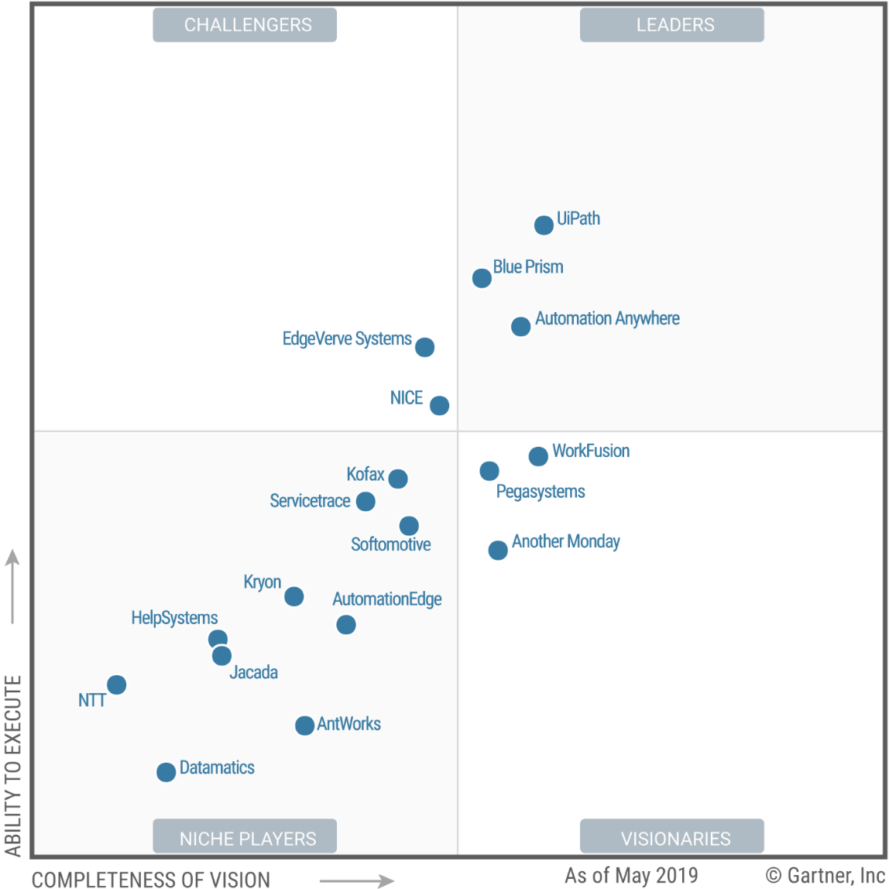
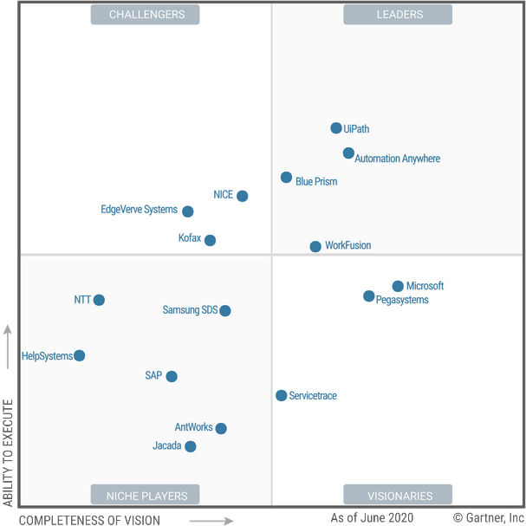
RPA MQs
2019
2020

Slide 46
Once Upon a Time: Started with Stand Alone RPA
Over a 6 year period, RPA software had a very high growth (at times, triple digit growth). This accelerated the interest, discussion and exploration of automaton possibilities.
RPA

Slide 47
Shift to Complemented RPA
Complemented RPA
Process Mining
Analytics
Of Process
Process Mining
Analytics
Of Process
UX Customer Exp.
RPA
Ingestion Engine
RPA
UX /
CX
Ingestion Engine
Machine Learning
Machine Learning

Slide 48
2020: Accelerated Activity
(2020) Pureplay RPA Vendors Raise $2.7B
Total
SAP
Acquires
Contextor
(Nov 2018)
BluePrism Acquires Thoughtonomy
(Jul 2019)
Automation Anywhere
Acquires Klevops (Aug 2019)
UiPath
Acquires ProcessGold &StepShot
(Oct 2019)
Appian
Acquires
Jidoka
(Novayre) (Jan 2020)
Microsoft
Acquires
Softomotive
(May 2020)
IBM Acquires WDG (Jul 2020)
Alpha Omega Acquires
Confiance Group (Aug 2020)
Celonis
Acquires Integromat
(Oct 2020)
2018
2019
2020
2021
(2018)
Pureplay RPA
Vendors Raise Over $1B
Arbry
Acquires
Asignet
(Feb 2020)
ISG Acquires Tech Ed Neuralify
(Jul 2020)
Hyland Soft Acquires Another Monday (Aug 2020)
Netcall Acquires Automagica (Oct 2020)
Nintex Acquires K2 Software Inc (Oct 2020)
Midis SI Group Acquired MAGNOOS RPA Consulting
(Oct 2020)
Notes:
2020 RPA Mergers and Acquisitions: Deal List
Here’s a list of M&A deals and investments that ChannelE2E has tracked.
October 2020: Automation software provider Netcall acquired RPA software company Automagica.
October 2020: Nintex, backed by private equity firm Thoma Bravo, acquired K2 Software Inc.
October 2020: Midis SI Group acquired MAGNOOS Information Systems, an RPA consulting firm & Automation Anywhere partner.
August 2020: Hyland Software, backed by private equity firm Thoma Bravo, acquired Another Monday.
July 2020: IBM acquired WDG.
July 2020: UiPath raised $225 million in Series E funding.
July 2020: Information Services Group (ISG) acquired RPA technology educator Neuralify. The goal: Help customers accelerate RPA developer education & automation projects.
May 2020: Microsoft acquired Softomotive for Robotic Process Automation (RPA). Vows to ensure all partners can “create bots to automate manual business processes.”
February 2020: Private equity firm Abry Partners invested in Asignet, an MSP that’s preparing a robotic process automation (RPA) software platform called Robot4IT.
What is Digital Process Automation (DPA)?
DPA represents the evolution of Business Process Management (BPM) technologies. BPM takes the entire infrastructure of an organization’s business processes and streamlines processes to increase efficiency and reduce cost.
Digital Process Automation evolved out of the need for organizations to automate business processes to achieve digital transformation. DPA aims to extend business processes to partners, customers, and supplies, giving them better experiences when they interact with the organization. It sounds a lot like BPM. So, what’s the difference between BPM and DPA? DPA assumes that business processes are already digitized and ready to be optimized.
Key principles of DPA include:
Maintaining transparency
Triggering notifications
Automating customer tasks
DPA can be used in common tasks like customer onboarding, purchase orders, credit approvals. The types of work DPA can address are primarily broken down into three categories, programmatic, transactional, and exploratory.

Slide 49
RPA Investment Trends
On Pace to Surpass $1 Billion – 3rd Year in Row

Slide 50



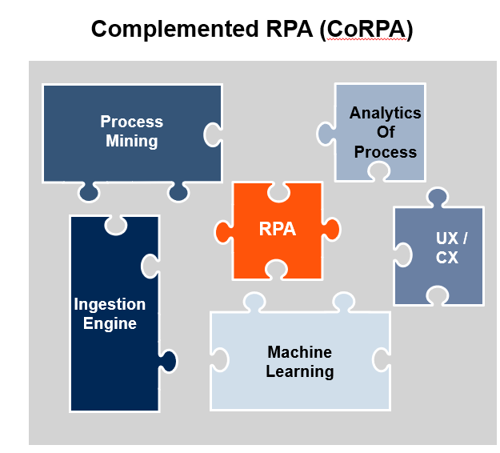


Morph to Hyperautomation
Hyperautomation
3
Deliver/Production
Business Objectives (Digital Ambition)
1
Measure, Iterate, Optimize
5
Deliver
Solutions
Imagine
Vision and Options
Explore
Prototypes
Scale
Outcomes
2a
Business Process Analysis
2b
Technology Exploration
4
Govern and Scale
Accelerated Path to Hyperautomation
RPA

Slide 51
Gartner Teams

Slide 52





Gartner Hyperautomation Core Team
IT Leaders Analysts
Financial Services Analysts
Frances Karamouzis Chief of Research and Distinguished VP Analyst
20 years at Gartner / 33 years industry experience
Nicole Sturgill VP Analyst
12 year at Gartner / 14 years industry experience
Stephanie Stoudt-Hansen
Sr. Director Analyst 4 years at Gartner / 26 years industry experience
Laurie Shotton VP Analyst
6 year at Gartner / 19 years industry experience
Melanie Alexander Sr. Principal Analyst
4 years at Gartner / 25 years industry experience

Slide 53








Gartner Applications Group
North American Analysts
RPA Analysts & Advisors
Van Baker
VP Analyst 29 years at Gartner / 39 years industry experience
Saikat Ray Sr Director Analyst 2 years at Gartner / 20 years industry experience
Whit Andrews Distinguished VP Analyst
20 years at Gartner / 24 years industry experience
Naved Rashid Assoc Principle Analyst
1 year at Gartner / 6 years industry experience
Bern Elliot Distinguished VP Analyst
20 years at Gartner / 43 years industry experience
Rob Dunie Sr. Director Analyst
7 years at Gartner /20 years industry experience
European Analysts
Brian Manusama Sr. Director Analyst
6 year at Gartner / 22 years industry experience
Anthony Mullen
Sr Director Analyst
4 years at Gartner/ 31 years industry experience

Slide 54






Gartner AI team (Data & Analytics Group)
North American Analysts
European Analysts
Erick Brethenoux
VP Analyst 2 years at Gartner / 30 years industry experience
Pieter den Hamer Sr. Director Analyst
2 year at Gartner / 27 years industry experience
Alex Linden
VP Analyst
7 years at Gartner/ 36 years industry experience
Frances Karamouzis Chief of Research and Distinguished VP Analyst
20 years at Gartner / 33 years industry experience
Svetlana Sicular VP Analyst
8 years at Gartner / 27 years industry experience
Asia Pac
Shubhangi Vashisth Sr Principal Analyst
5 years at Gartner / 13 years industry experience
Farhan Choudhary Assoc Principal Analyst
1 years at Gartner /
15 years industry experience

